Slide 1
Ibm data analyst Capstone project:
Analysis on Emerging Technology Skills & Trends
Wael Mohammed
2th December 2023

Slide 2

Outline
Executive Summary
Introduction
Methodology
Results
Discussion
Conclusion
Appendix

Slide 3

Executive Summary
From AI and automation to the metaverse and beyond, the future is powered by code.
Programming languages and databases are the building blocks of innovation, and the landscape is rapidly evolving.
This presentation will delve into the hottest trends in the programming world, highlighting the languages and databases you need to know to stay ahead of the curve.

Slide 4
INTRODUCTION
The Presentation’s purpose will give insights to the responsible business’ stakeholders, in effective decision making upon IT Consulting Services;
Answering the right questions, namely which are the current and immerging technologies in the market will drive the company to identify future skill requirements, utterly making the provided services more effective and precise;
Along the presentation, ideas and recommendations will be provided, based on the implementing Data Analysis techniques.

Slide 5
METHODOLOGY
Data in several formats, such as the number of jobs currently available for different technologies and for different places, were gathered using Github jobs API on python.
To obtain the names of the programming languages and their yearly wages, the IBM website was scraped. The dataset from a 2019 Stack Overflow developer survey was download and saved.
Python was used to clean and analysis the data. To assess the distribution of data, the presence of outliers, and the correlation between various columns in the dataset, an exploratory data analysis was carried out.
Charts, graphs, and dashboards were create using python and Cognos analytics to visualize the data. All the python analysis were carried out on Jupyter notebook through visual studio.

Slide 6
RESULTS
Visualization – Charts
Dashboard

Slide 7
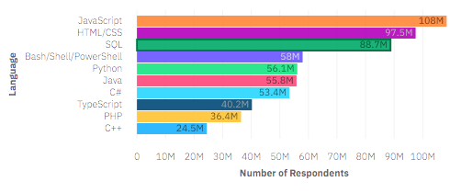
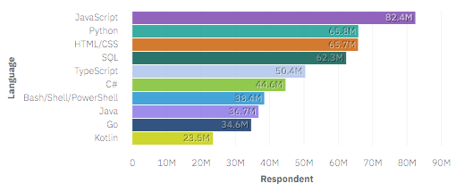
PROGRAMMING LANGUAGE TRENDS
Top 10 programming Language for current year
Top 10 programming Language for next year

Slide 8
PROGRAMMING LANGUAGE TRENDS - FINDINGS & IMPLIC ATIONS
Findings
JavaScript is top trending language in the world
Python and TypeScript are becoming more and more popular
HTML/CSS and SQL still has great portion in language usage trend
Implications
Web developments and Web developers are still in high demands
JavaScript and TypeScript are crucial to learn for developers
Python is the new trending language, especially popular in AI fields

Slide 9
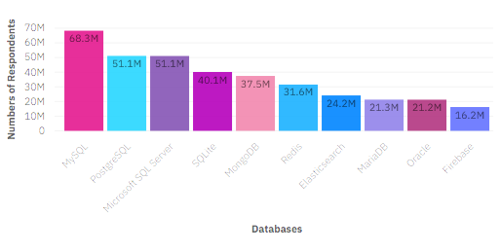
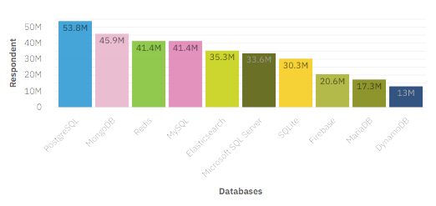
DATABASE TRENDS
Top 10 Databases for current year
Top 10 Databases for next year

Slide 10
DATABASE TRENDS - FINDINGS & IMPLICATIONS
Finding
MySQL is the most popular database
There are still a lot of companies using Microsoft SQL Server
MongoDB and Redis are the most favorable NoSQL database
Implication
Open-source databases like MySQL are still preferable
Software development and Big Data technology still requires SQL
NoSQL databases will make an impact for relational databases

Slide 11
DASHBOARD
The permanent link of the Cognos dashboard:
https://eu-de.dataplatform.cloud.ibm.com/dashboards/d54db0f4-7676-4213-b409-547d3f30e3f5/view/0f67ff031b922ce269dcc4e4079f29537836265bb1bb8606d6d37b490c317897f33a42c7c87c4d0bdc440761f3be400acf

Slide 12
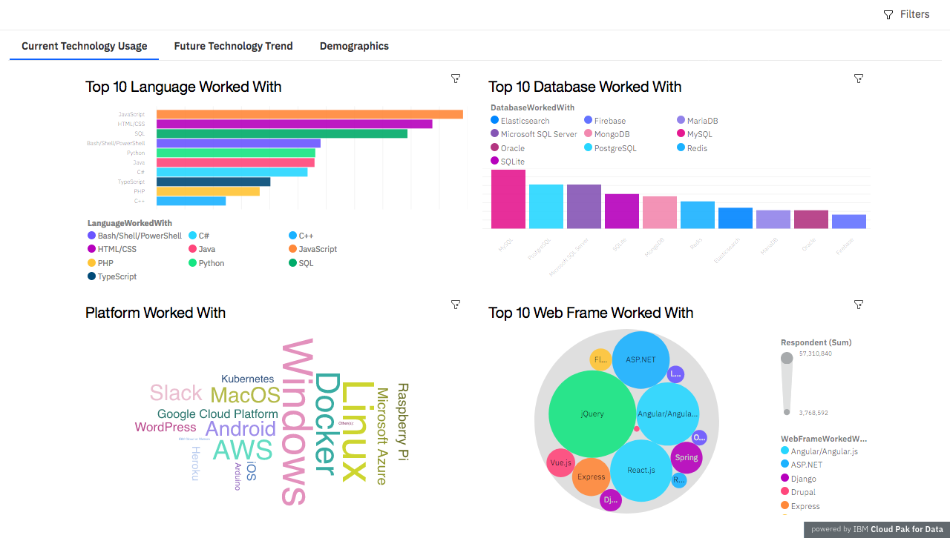
DASHBORAD TAB 1

Slide 13
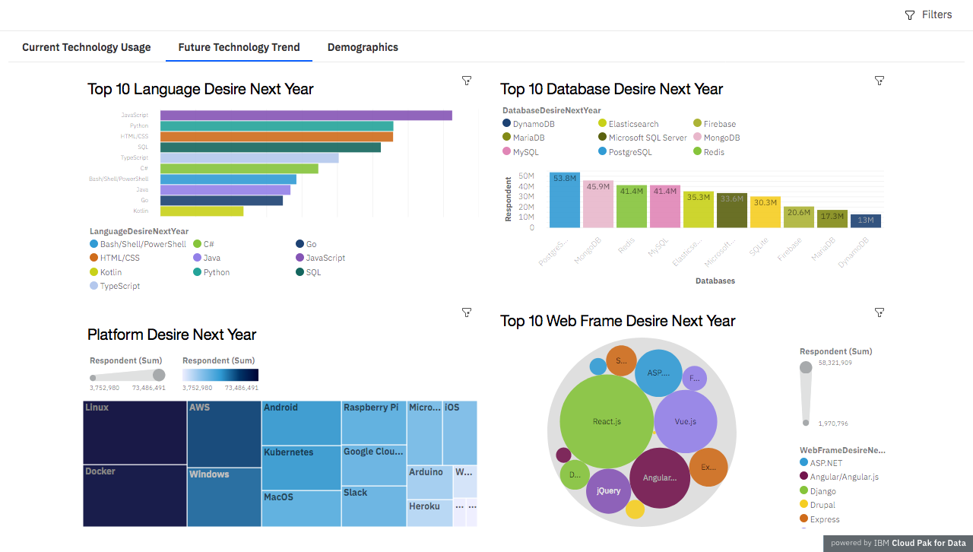
DASHBORAD TAB 2

Slide 14
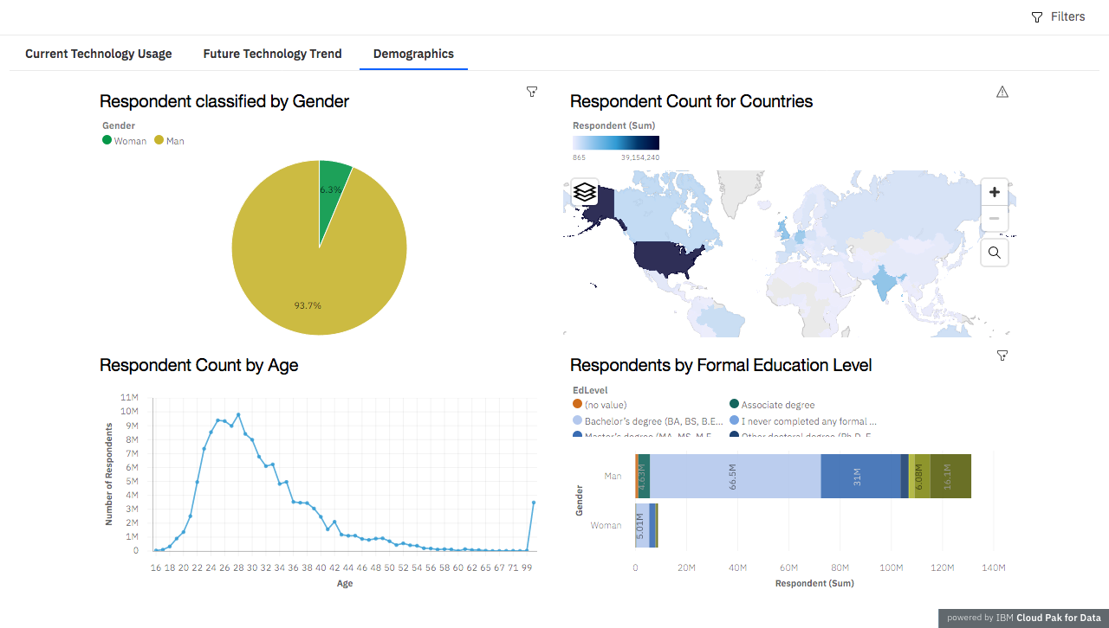
DASHBORAD TAB 3

Slide 15
DISCUSSION
Upskilling in the technology sector.
How do we close the wide gender gap in the technology sector.
Is completing a master or doctorate degree really a requirement.
The increasing demand for mobile development as kotlin is getting popular.
More tech education access and development in less developed regions in south east Asia, south America, Africa and some parts of Europe.
How relevant will Oracle SQL still in the future.

Slide 16
OVERALL FINDINGS & IMPLICATIONS
Findings
Technology trends changes every year
USA is the top technology country
There are extreme gender and age discrimination
Docker and AWS are the most popular platform
Implications
Programmers should always follow the latest technology trends
More countries should have the equal chance to be exposed to new technology
Gender and Age should not be one of the concerns or benefits of Employment

Slide 17
CONCLUSION
Offering educational programs to the staff that is already established into the company.
Providing them with the adequate tools to upscale their knowledge in the up-to-date technologies.
Making rearrangements & prioritizing technologies that are on demand.

Slide 18
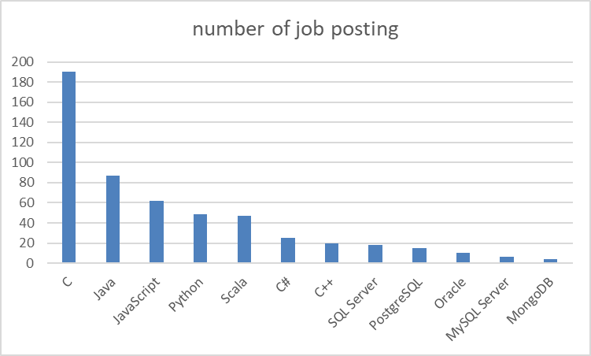
APPENDIX
Chart presenting the job posting data collected using GITHUB job API.

Slide 19
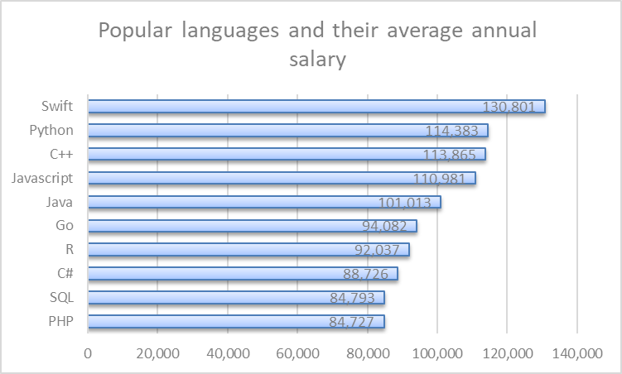
APPENDIX
Chart presenting popular languages and their annual salary the data was collected through web scraping GITHUB jobs data.

